Slide 1
You’ll Be Fine!
Guided By:
Professor Anurag Lakhlani
TA Riya Shah
TA Naishi Shah

Slide 2
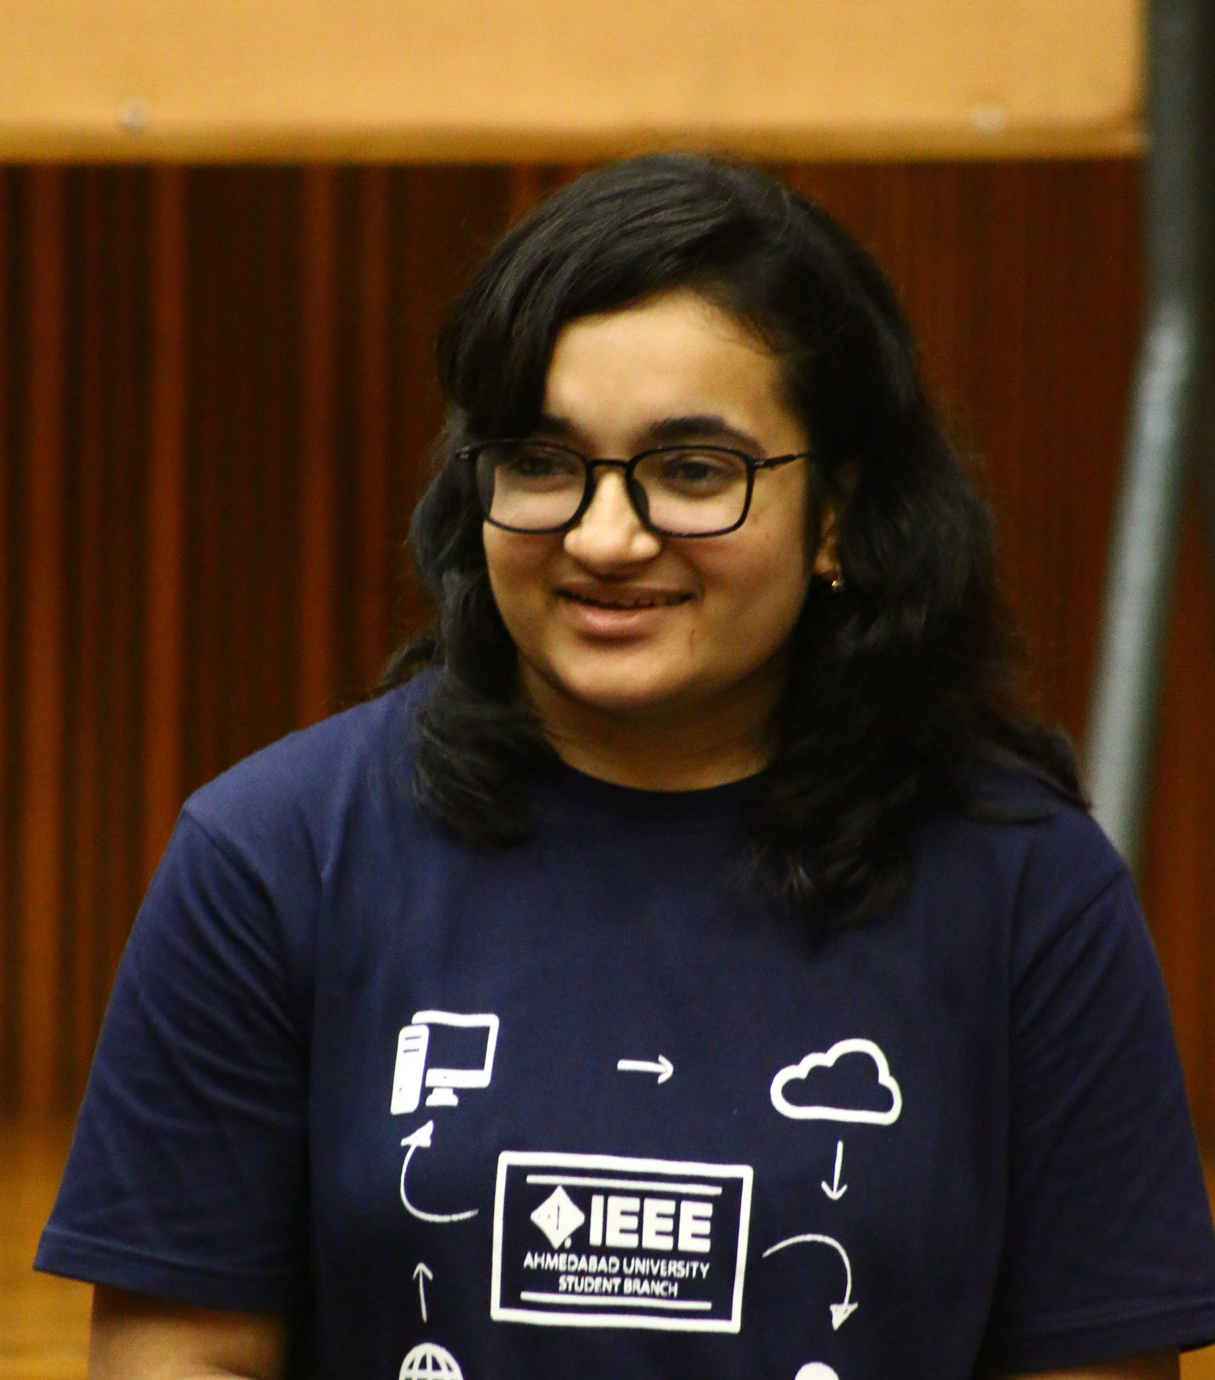

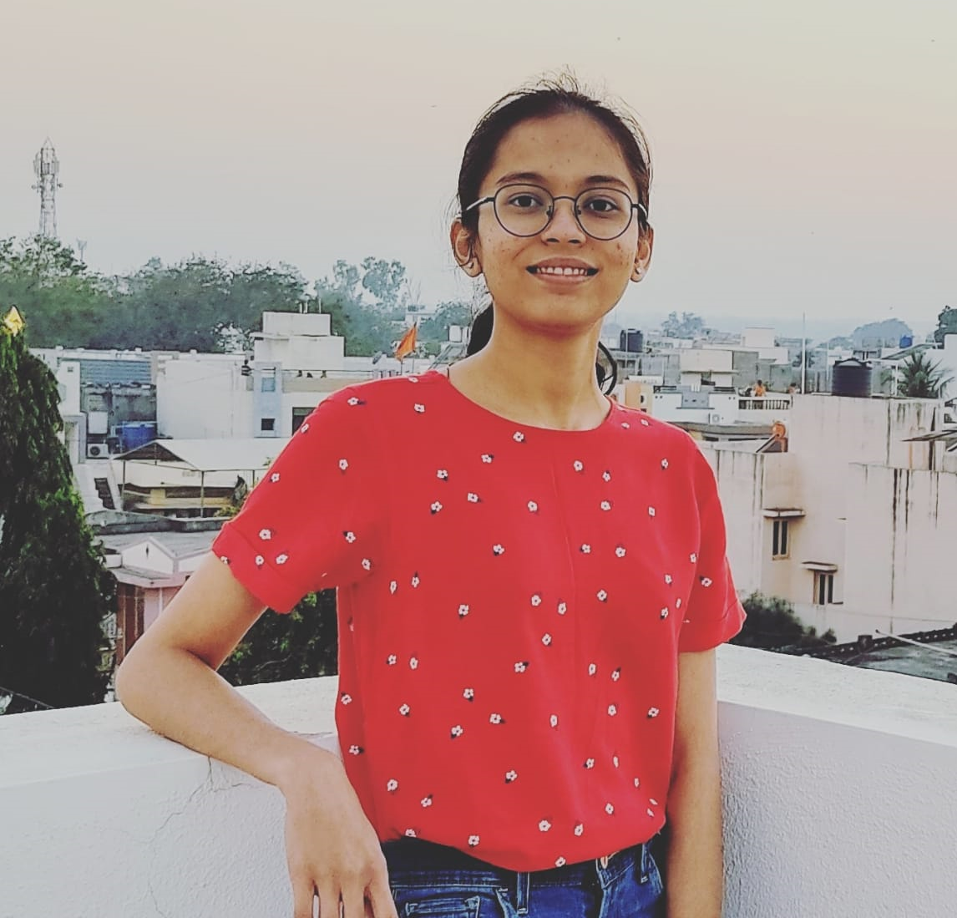
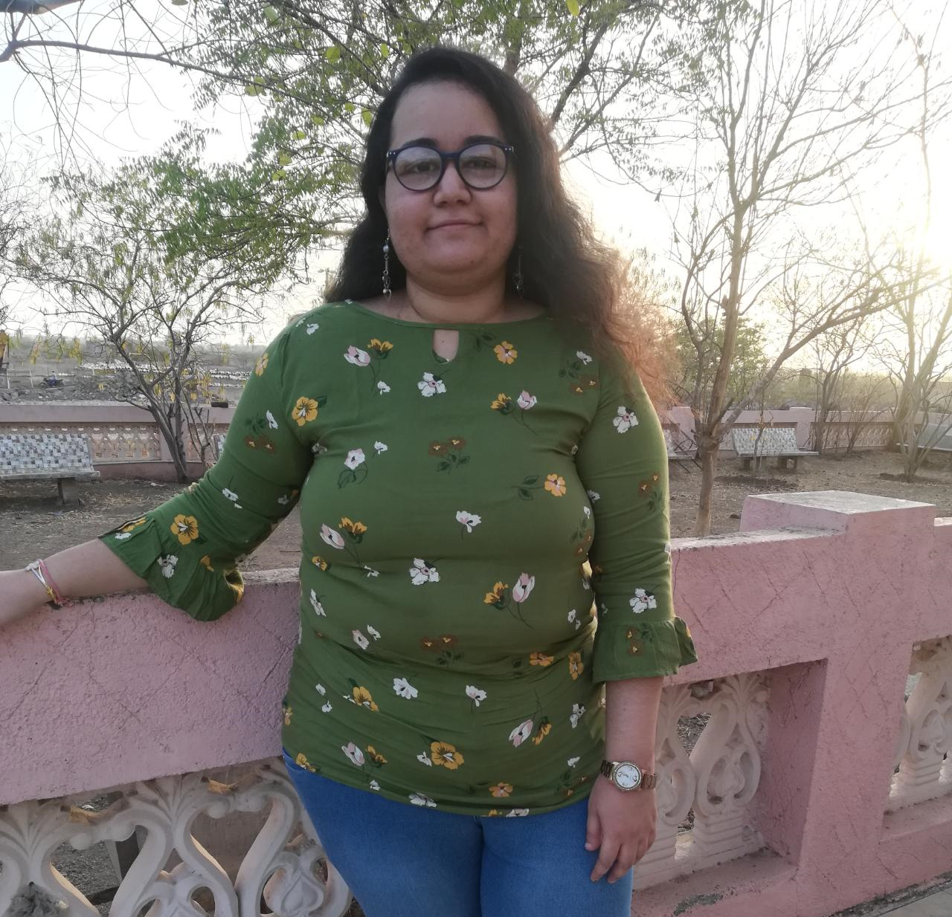
Group 07: Runtime Terror
Miracle Rindani
Bhumiti Gohel
Nirva Sangani
Frency Chauhan
AU1841017
AU1841051
AU1841074
AU1841105

Slide 3
01
04
Motivation
Difficulties Faced
02
05
Project Overview
Real Life Implementation Issues
03
Some Features

Slide 4
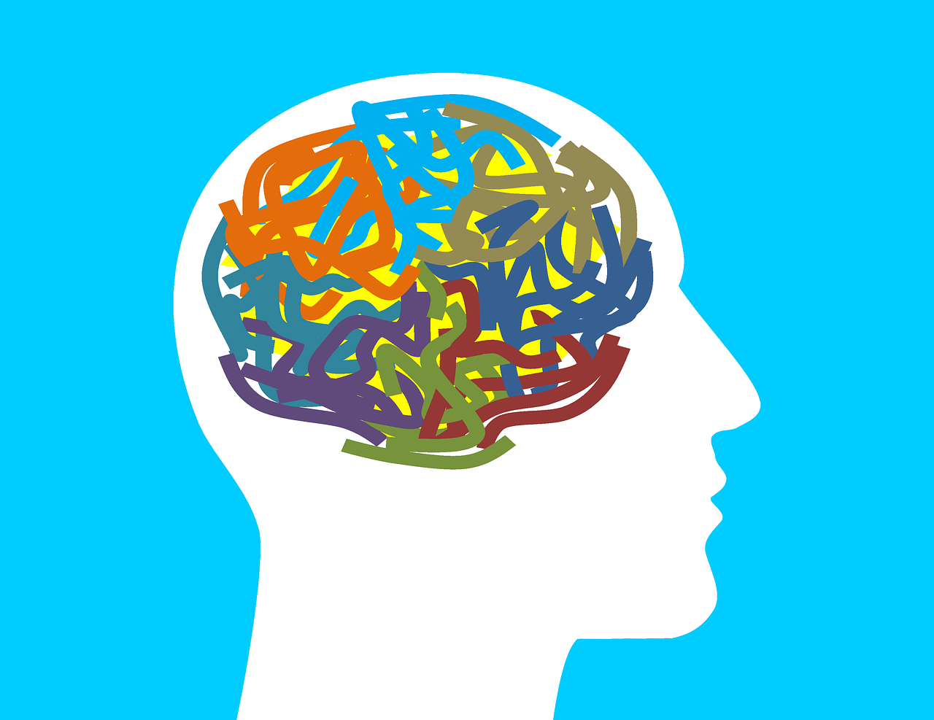
Motivation
Mental health is a crucial part of a person’s overall well-being.
While talking about one’s mental health is still considered a taboo in many societies, this is an alarming issue worldwide.

Slide 5
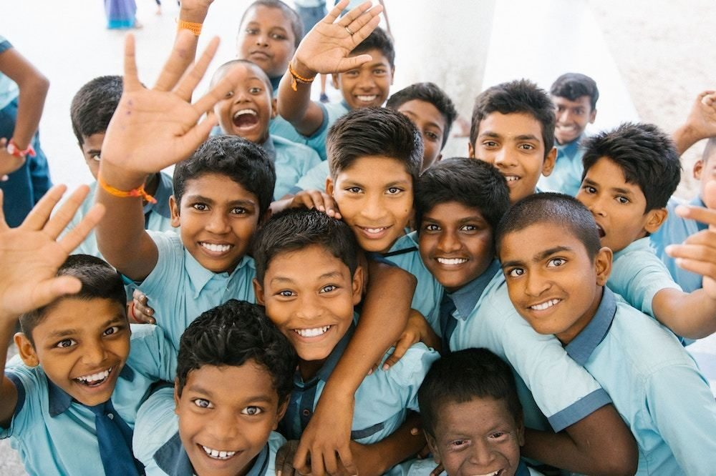

According to WHO….
20%
1/5
Of the world’s children and adolescents have a mental health condition.
People in post-conflict settings have a mental health condition.

Slide 6

Overview
"You'll be fine" is an application to come to when you feel overwhelmed with thoughts, emotions and feelings and express yourself. Its different features help the user to cope up with mental health related issues in various ways, building an environment of inclusivity of mental health care as part of overall wellness of the user.

Slide 7
Key Features

Slide 8
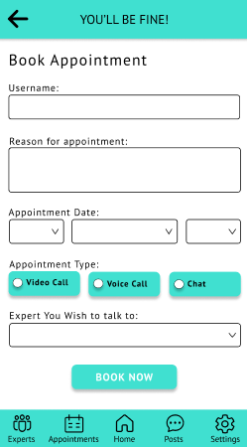
Appointment Booking
Helps the user book appointments with our experts
Design Principles:
Consistency
Cater for Universal Usability
Offer Informative Feedback
Design Dialogues to Yield Closure
Permit Easy Reversal of Actions
Support Internal Locus of Control
Universal Usability Principles:
Personality Differences
User with Disabilities

Slide 9
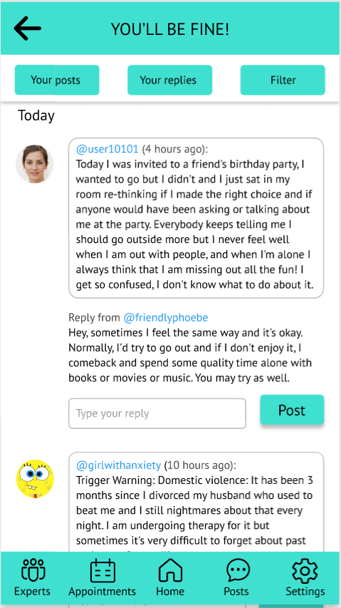
Public Posts
Let’s the user share their thoughts with others
Design Principles:
Consistency
Cater For Universal Usability
Offer Informative Feedback
Reduce Short Term Memory Load
Visibility

Slide 10
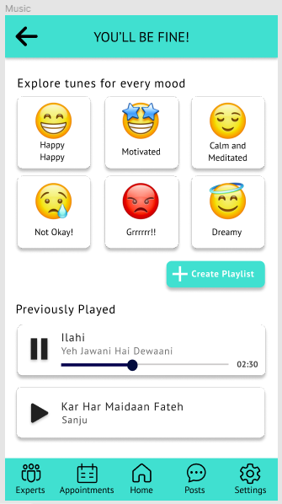
Music
Let’s the user listen to music to calm their nerves
Design Principles:
Consistency
Support Internal Locus of Control
Offer Informative Feedback
Personality Differences

Slide 11
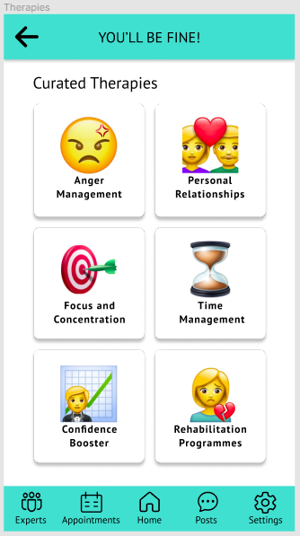
Curated Therapies
Helps the user enroll into special sessions to get rid of or develop certain habits
Design Principles:
Consistency
Support Internal Locus of Control
Universal Usability Principle:
Personality Differences

Slide 12

Difficulties Encountered and Resolved
Time taking exploration of Figma
Collaboration difficulty with Figma
No option of database and data validation in Figma
Different designs for different devices need to be made

Slide 13
Real Life Implementation Challenges

Slide 14
Technical Challenges
Implementing Multi-user system
Algorithm for Self-test
Efficient Database
Internal Locus of Control
User data security
Language & Device Support

Slide 15
Social Challenges
Raising Awareness
Experts Assignment
Therapy Curation

Slide 16
Thank You!

